Slide 1
Section 7.5
Binomial Distribution

Slide 2
What is a Binomial Distribution?
When calculating probabilities that involves repeated “Trials”, with the probabilities of “success” and “failure” being complements but not equal, we would use a binomial distribution to calculate the probability
Ie: The probability of guessing a correct answer from a Multiple choice test is 1/5. What is the probability of getting 4 correct answers out of 12 questions?
ie: In a population where 4% are potential clients. You randomly select 30 people to call. What is the probability that 8 of them will become customers?
“Binomial” means that it can have only two outcomes: Success OR Failure
It is called a “Distribution” because the number of success “X” can range from 0 to ‘n’ [total number of trials], distribution is a bell shaped curve

Slide 3
When can we use a Binomial Distributions
Binomial outcomes: Only TWO outcomes for each trial
  ie; Pass or Fail, boy or girl, true of false, Right or Wrong
Independence: Each trial must independent from one another
  Outcome of any individual trial doesn’t affect the probabilities in other trials
Fixed “N”: There must be a fixed number “n” of trials
Probability: the probability of success of every trial must be the SAME
  ie: The probability of success for every trial NEVER changes!! Replacement!
Purpose: Calculates the probability of “X” number of successes in “N” number of trials
  Ie: 5 correct in 10 questions → x = 5, n=10

Slide 4
Ex: In each of the following cases, decide whether or not a binomial distribution is an appropriate model, and give your reasoning:
a) You draw 10 cards from a deck without replacement and then find the probability of getting 4 cards that are clubs
No, because the probability of getting a club after each draw is changed
b) 30 women in a hospital gives birth to a child. The probability that 10 of the births are females
Yes, the outcomes can be only be female OR not female. Each birth is independent of the other. The probability of each birth being female is 50/50
c) A scientist conducts a solubility test 20 times on the same substance. He raises the temperature by 3 degrees after each test. She counts the number of times a chemical reaction would occur. What is the probability that half of the trials will create a reaction?
No, because the increase in temperature changes the outcome in each trial
d) Timothy wants to know how many girls will go out with him. He decides to ask all the girls in his grade to go on a date with him. What is the probability that 10 girls will say yes?

Slide 5
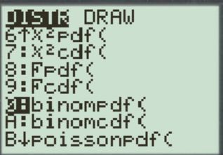
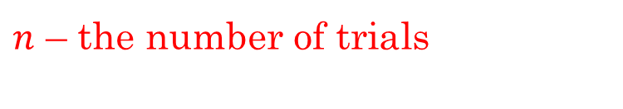
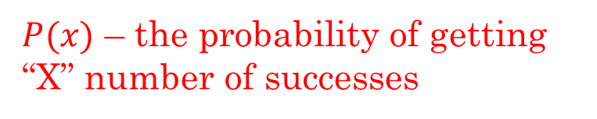
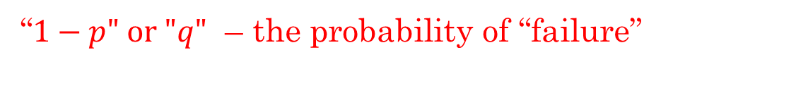
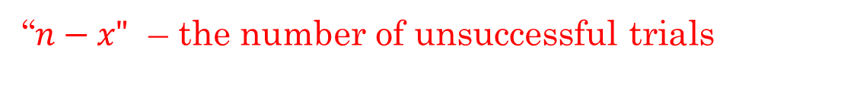
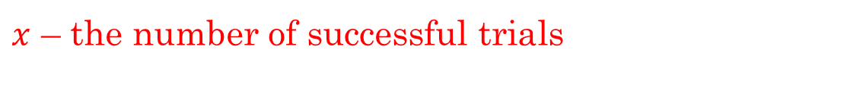
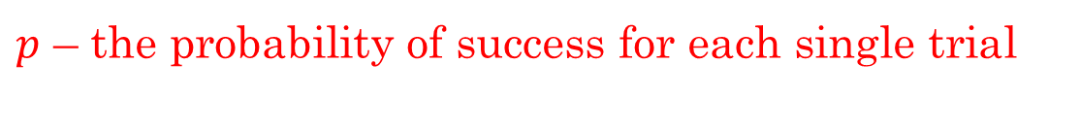
Formula For Binomial Distribution
Suppose you have “n” trials and the ‘p” is the probability of success for each trial. The probability of getting “X” number of successes in “n” trials is:
$P(x)$ – the probability of getting “X” number of successes
$n$ – the number of trials
$p$ – the probability of success for each single trial
$x$ – the number of successful trials
“$n−x"$ – the number of unsuccessful trials
“$1−p" \text{or}\text{ "}q"$ – the probability of “failure”
We can use a Ti83 to calculate the binomial probability [partial] density function of “X” success in “n” trials

Slide 6
Ex: The probability that the Canucks will win a game is 64%. What is the probability that they will win 3 out of their next 4 games?
Ex: A basketball player has a free throw percentage of 85%. If he takes 5 shots, what is the probability he will make exactly 3 of them?
Practice: Suppose a biased coin is flipped 5 times and the P(h) = 0.65. What is the probability of getting 3 heads?

Slide 7
Ex: The probability that the Canucks will win a game is 64%. What is the probability that they will win 3 out of their next 4 games?
List out all the possible outcomes:
Calculate the probability of 3 wins
W W W L
W L W W
W W L W
L W W W
Calculate the probability of 1 Loss
Ex: A basketball player has a free throw percentage of 85%. If he takes 5 shots, what is the probability he will make exactly 3 of them?
There’s a 13.8 chance that he will make
exactly 3 of his 5 shots
© Copyright all rights reserved to Homework depot: www.BCMath.ca

Slide 8
Practice: Suppose a biased coin is flipped 5 times and the P(h) = 0.65. What is the probability of getting 3 heads?
List out all the possible outcomes:
Calculate the probability of 3 heads
H H H T T
H H T T H
H H T H T
H T H T H
Calculate the probability of 2 Tail
H T H H T
T H H T H
T H H H T
H T T H H
T H T H H
T T H H H
Alternative Method: Combinations
© Copyright all rights reserved to Homework depot: www.BCMath.ca

Slide 9
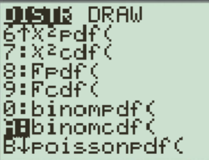
Cumulative Binomial Distribution
When the number of trials is large, the probabilities of binomial distributions are usually calculated “cumulatively” [together]
This is because the probabilities of exactly “X” number of successes can be very small
ie: NASA manufactured 1000 space rockets last year and the probability of a malfunctioning rocket is 15%. What is the probability that 5% of the rockets are poorly manufactured?
When calculating this probability, it’s not ONLY at 5%, but a range from 0% to 5%.

Slide 10
Playoff Series & “Atleast” Combinations
When solving questions involving playoff series, a best of 5 game series means that a team will need to win 3 games to win the series
In addition, a best of 7 game series will require 4 wins
When a team wins a series, the last game they play must be a win
Questions involving “atleast” will have multiple scenarios
Sometimes it’s easier to calculate the compliment
© Copyright all rights reserved to Homework depot: www.BCMath.ca

Slide 11
Ex: A multiple choice quiz has 10 questions with 4 choices in each question. If you randomly guessed what is the probability that you get exactly 4 questions correct?
There’s a 13.8 chance that he will make
exactly 3 of his 5 shots
Ex: A multiple choice quiz has 10 questions with 4 choices in each question. If you randomly guessed what is the probability that you get atmost 4 questions correct?
Atleast 4 means that you can have 0, 1, 2, 3, or 4 correct answers

Slide 12
c) What is the probability that you will pass the test?
d) What is the probability that you will get 90% on the test?
There’s a probability of 7.8% that you will pass the test

Slide 13
Practice: The probability that steve nash will make a free throw is 85%. What is the probability that he will make at least 8 of his next 10 shots?
Need to consider all the scenarios with getting: 8, 9, and 10 shots
There’s 82% that Steve Nash will make at least 8 of his next 10 shots
© Copyright all rights reserved to Homework depot: www.BCMath.ca

Slide 14
The Dallas Mavericks is playing a best of 7 game series against the Utah Jazz. The probability that the Mavericks will win a game is 55%. What is the probability that they will the series in 7 games?
Winning the series in 7 games means that there must be 4 W and 3 L
The last game must be a W, so in 6 games there are 3 W and 3 L
different scenarios
Calculate the probability of 4 wins
Calculate the probability of 3 Losses
© Copyright all rights reserved to Homework depot: www.BCMath.ca

Slide 15
Binomial PDF vs CDF
  PDF: Probability Distribution function
  Computes the exact probabilities at “X” number of successes
  2nd/Vars/0:Binompdf
  binompdf(n,p,x)
  ie: the probability of having exactly 4 correct answers
  CDF: Cumulative Distribution Function
  Calculates the sum of probabilities up to “X” number of successes
  2nd/Vars/A:binomcdf
  Binomcdf(n,p,x)
  ie: the probability of having atmost 4 correct answers

Slide 16
A bias coin is flipped 100 times. P(Head) = 0.7. What is the probability that you will get tails atleast 35 times?

Slide 17
Activity 9A
For each of the following questions, circle either A, B, C, or D
Question 1: A B C D
Question 2: A B C D
Question 3: A B C D
Question 4: A B C D
Question 5: A B C D
Question 6: A B C D
Question 7: A B C D
Question 8: A B C D
Question 9: A B C D
Question 10: A B C D
How many did you get correct?

